Slide 1
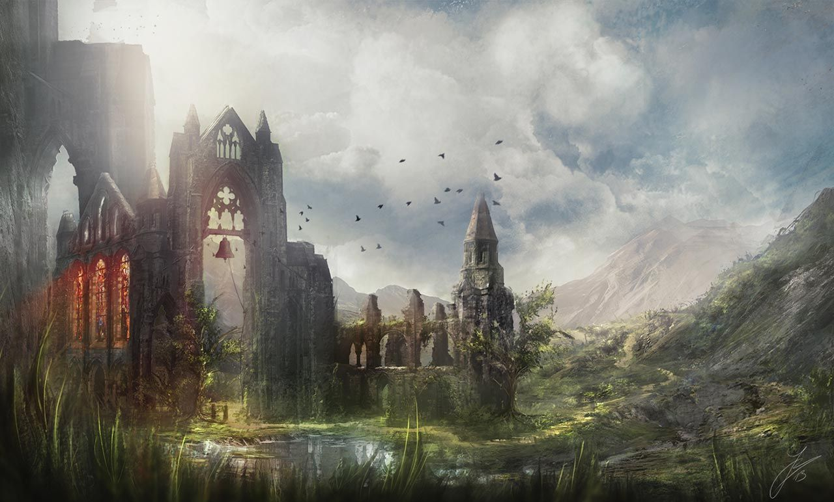
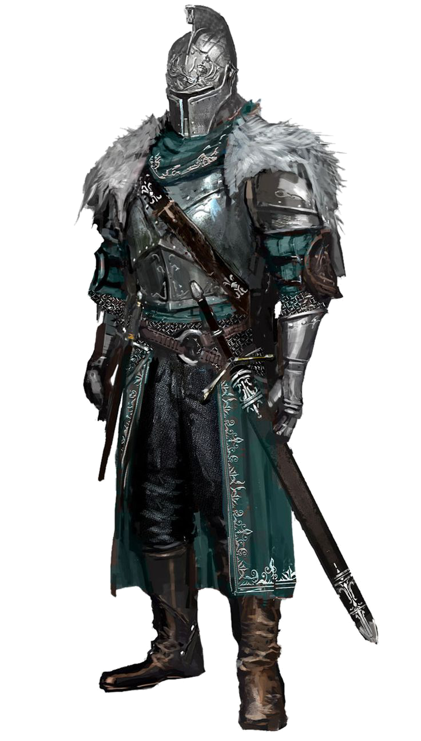
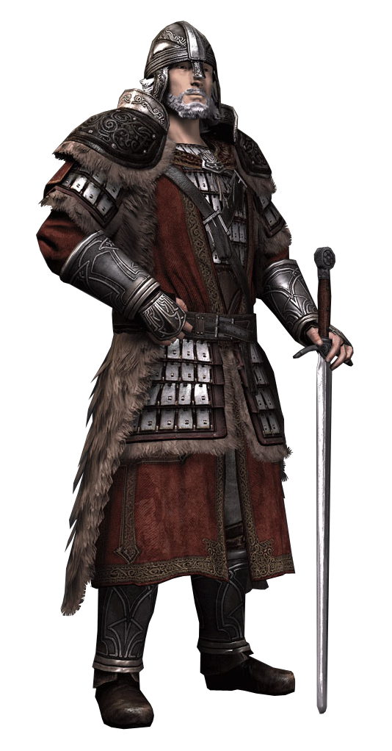

Medieval Adventure Game
Play
Save
Load
Quit

Slide 2
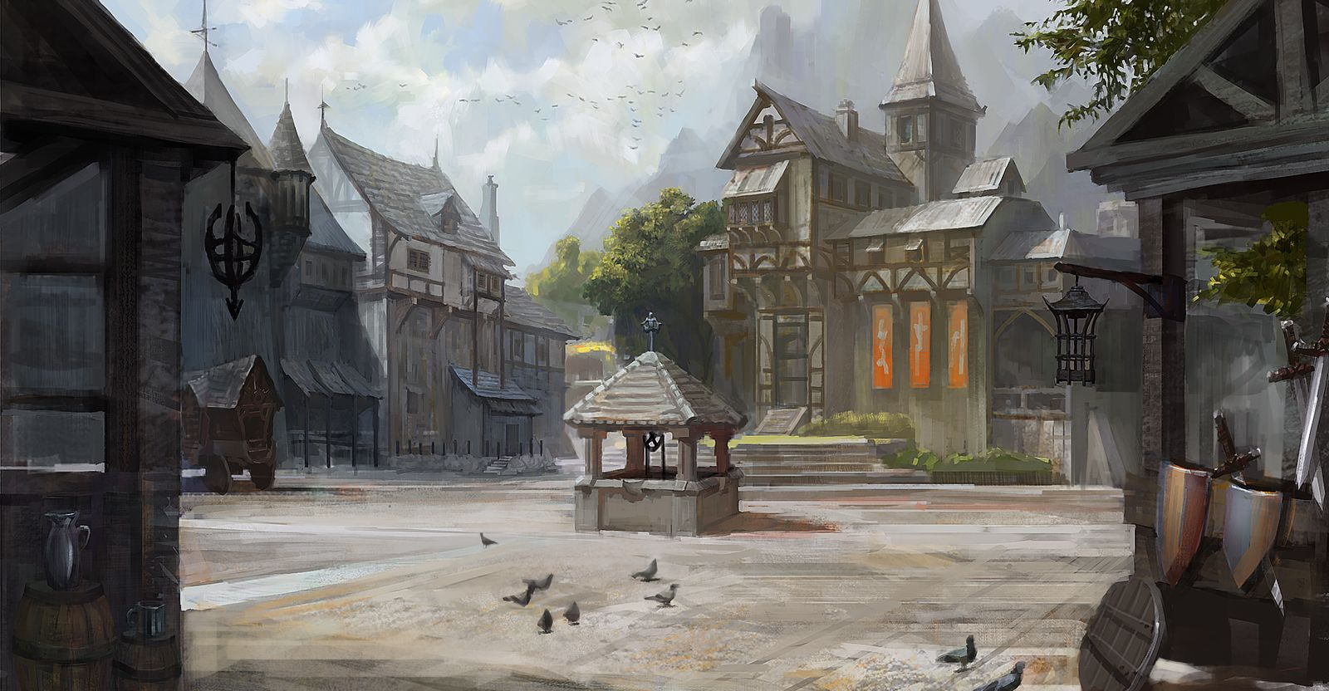
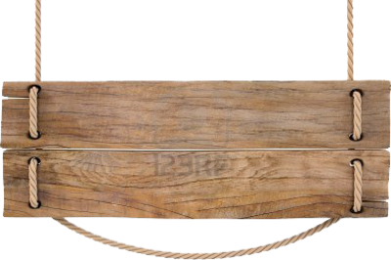
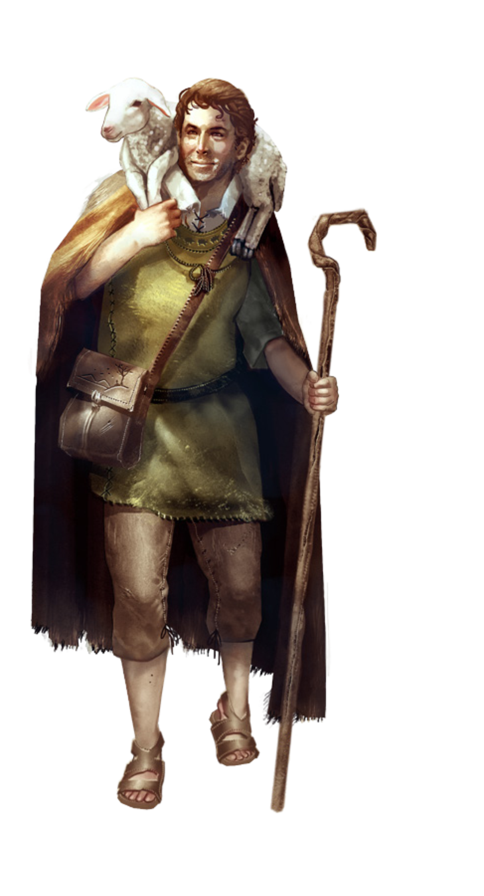
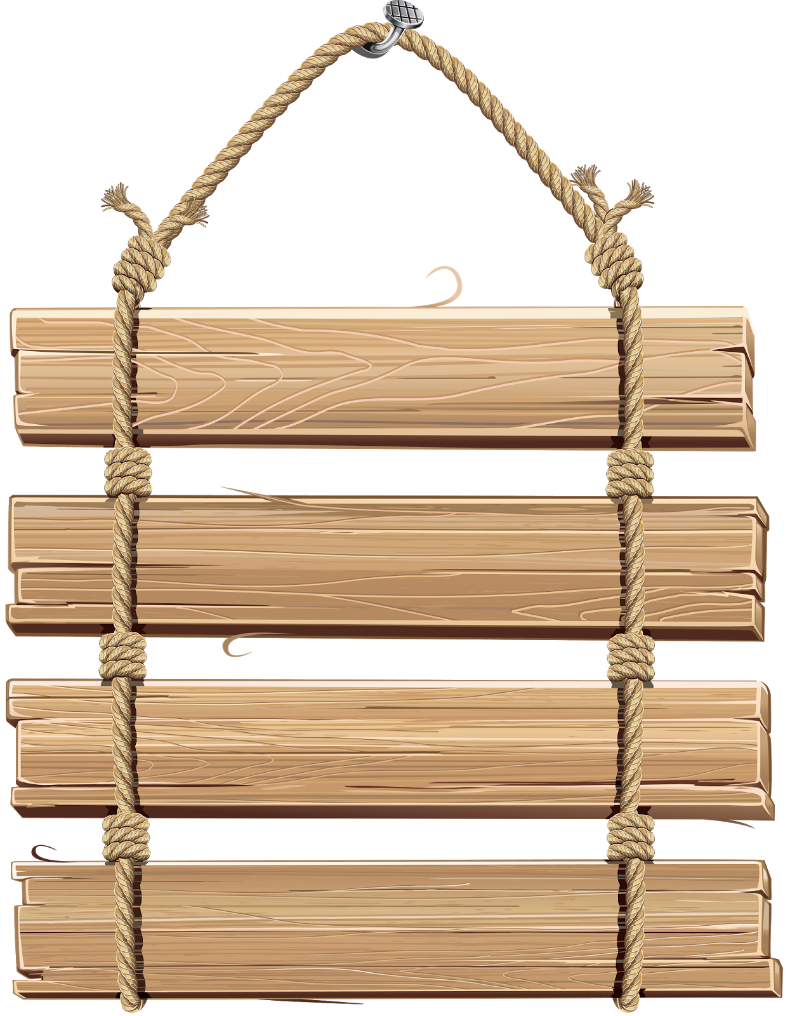






Quit
Battle
Armory
Market
Stats

Slide 3
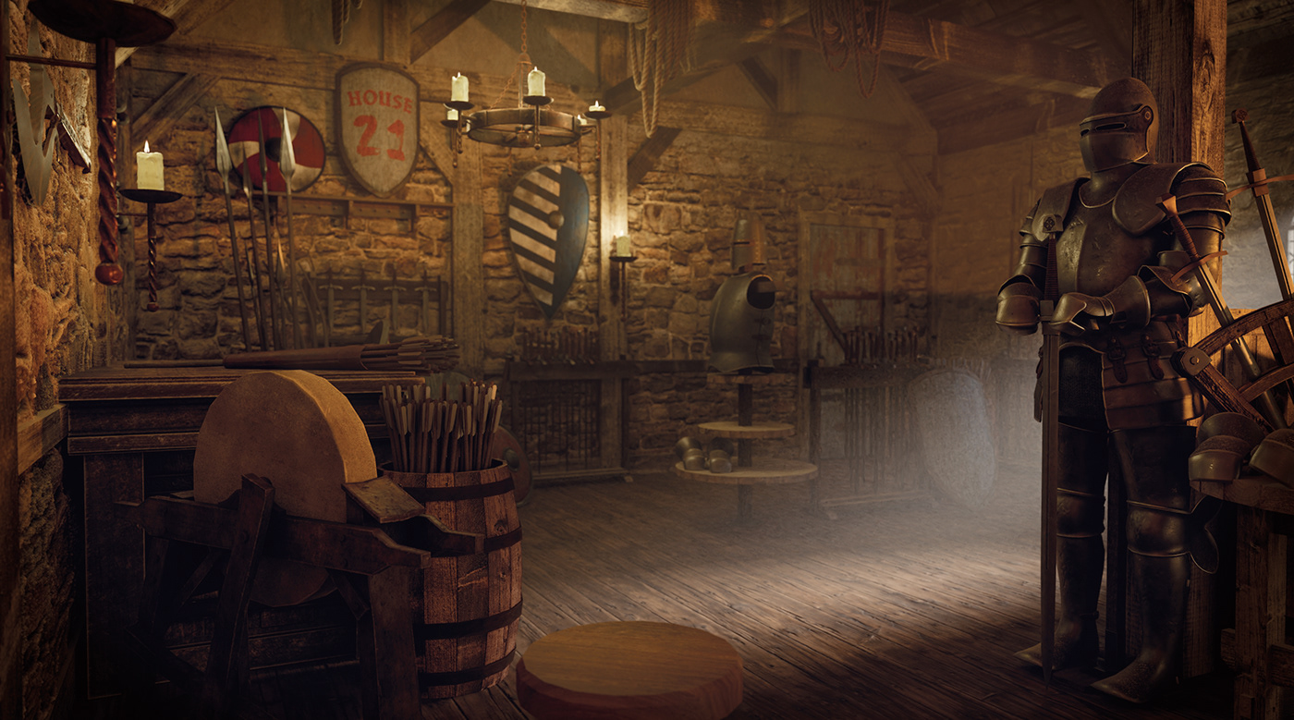
Equipment
Skills
Back Pack
Go Back

Slide 4
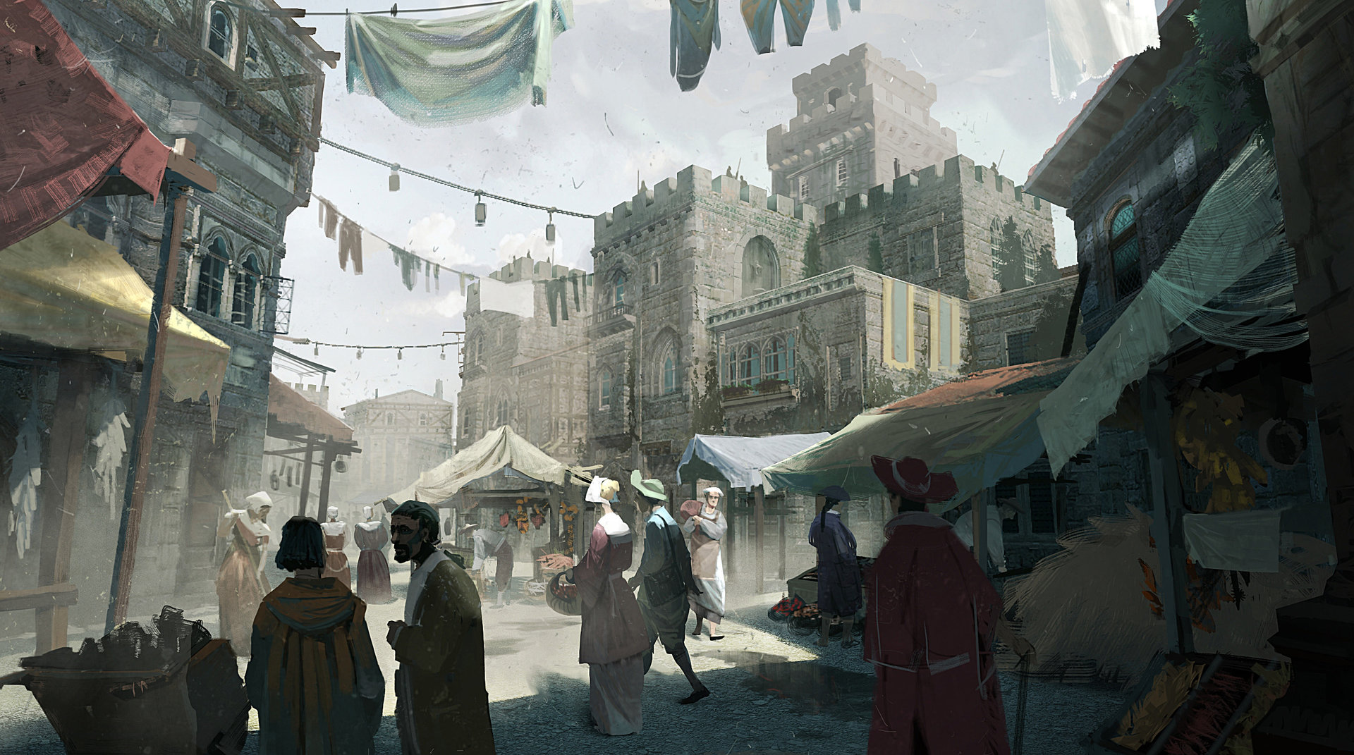
Weapons
Armor
Items
Blacksmith
Go Back

Slide 5
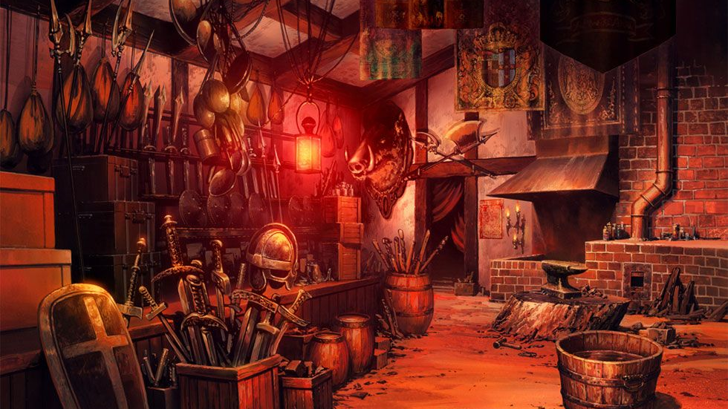

Slide 6
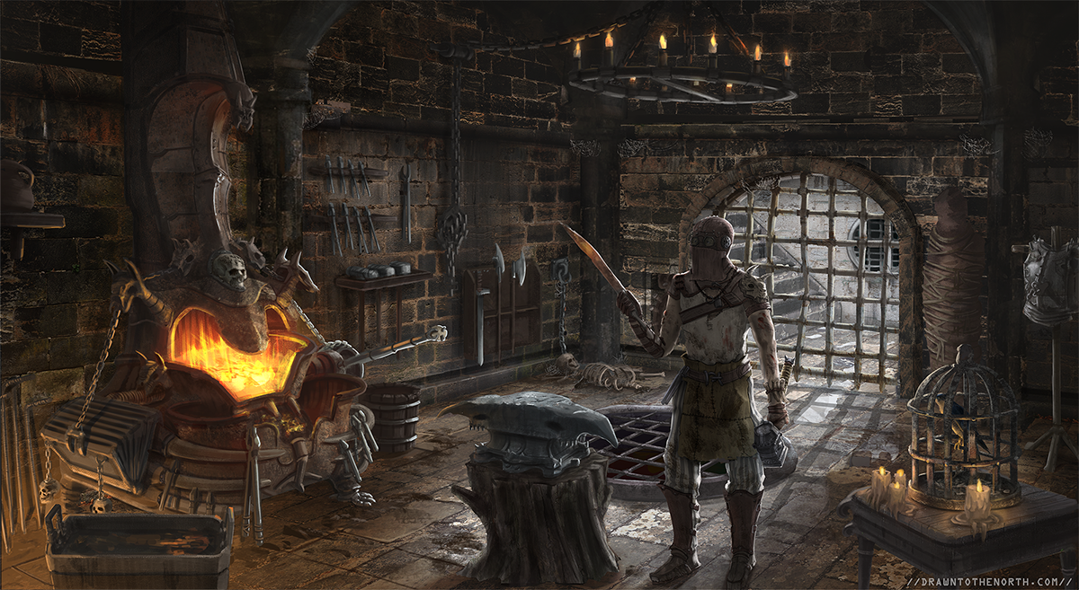

Would you like to repair your armor for 20 Gold?
No
Yes

Slide 7
Alright. Off you go then.

Slide 8
This won’t take long.

Slide 9
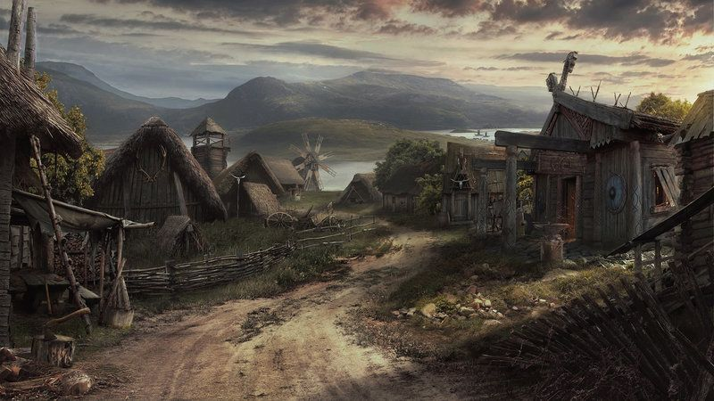
Training
Grounds
Level:
1
Fairy
Forest
Level:
2-3
Go Back
Pig
Prairie
Level:
4-5
Dragon’s
Den
Level:
6-7
Go Back

Slide 10
Normal
Go Back
Boss
Dungeon
Go Back

Slide 11
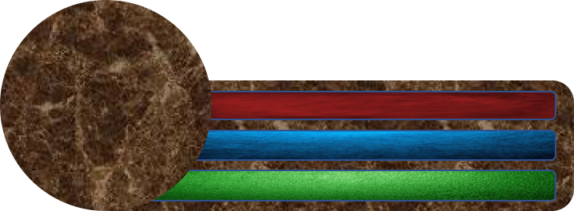
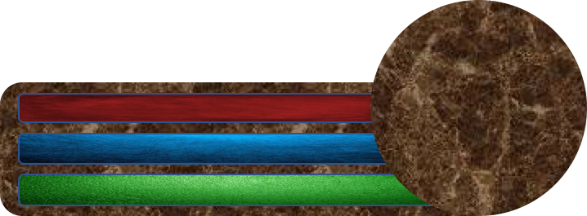
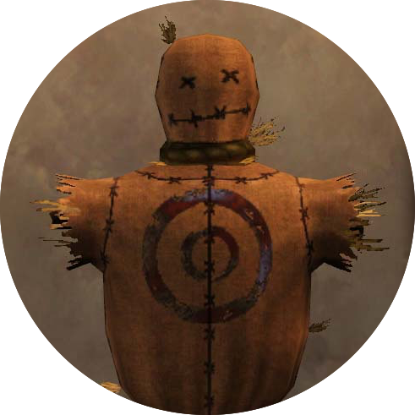

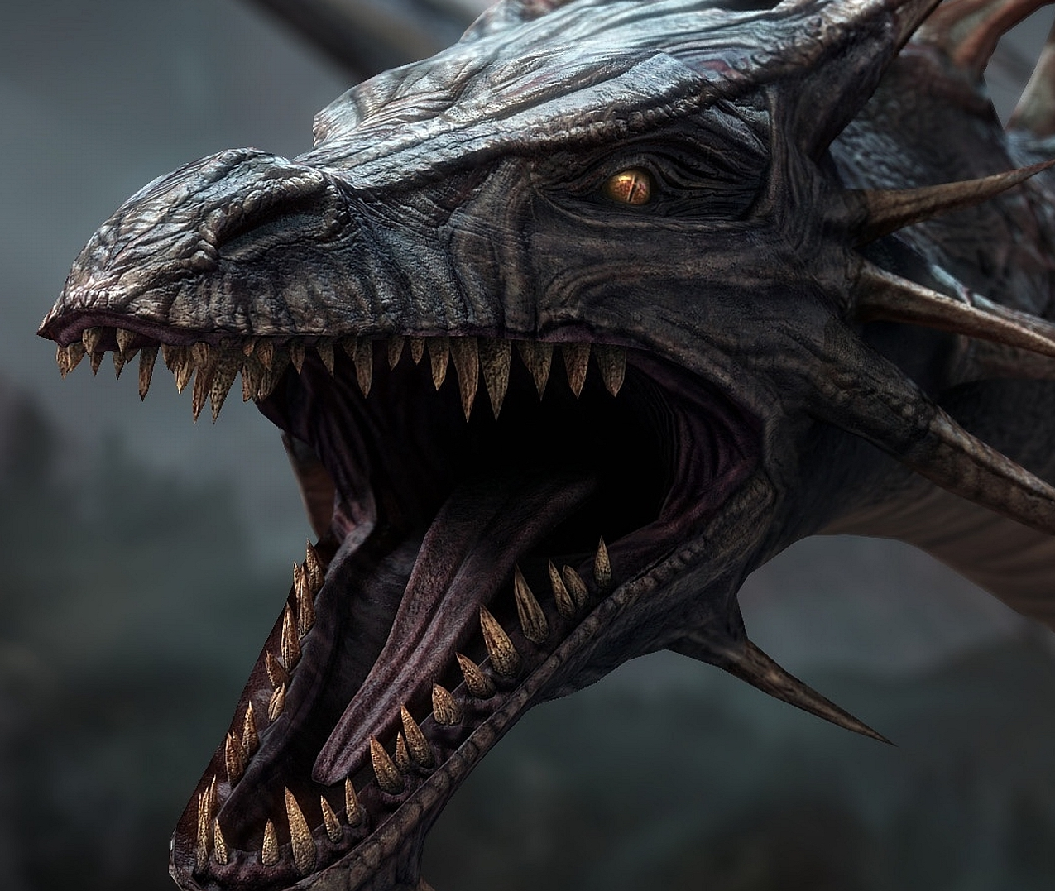
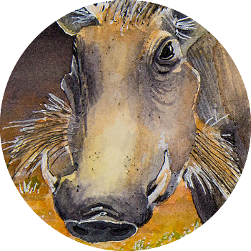

Slide 12
Skills
Attack
Items
Training
Grounds
Level:
1
Skills
Fairy
Forest
Level:
2-3
Items
Pig
Prairie
Level:
4-5
Flee
Dragon’s
Den
Level:
6-7
Go Back
Go Back
Go Back
Normal
Boss
Dungeon
Go Back

Slide 13
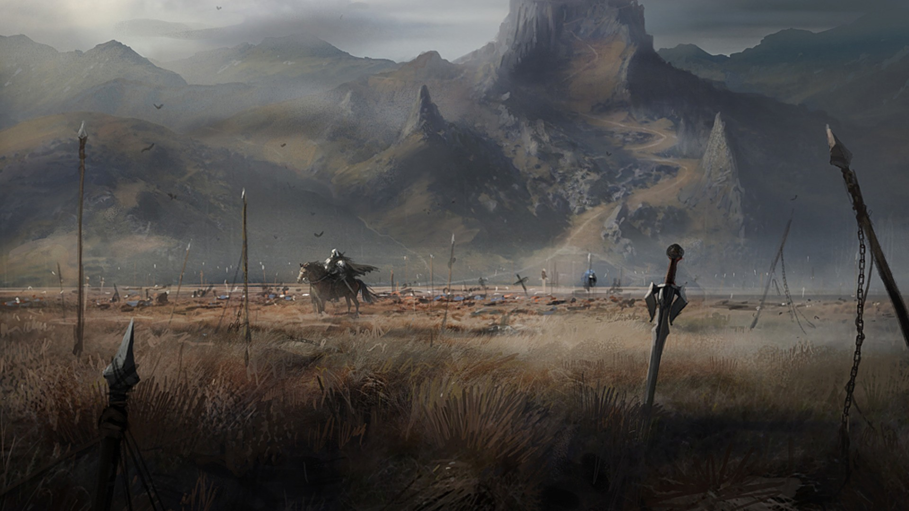

Slide 14
Save 1
Save 2
Save 3

